Slide 1
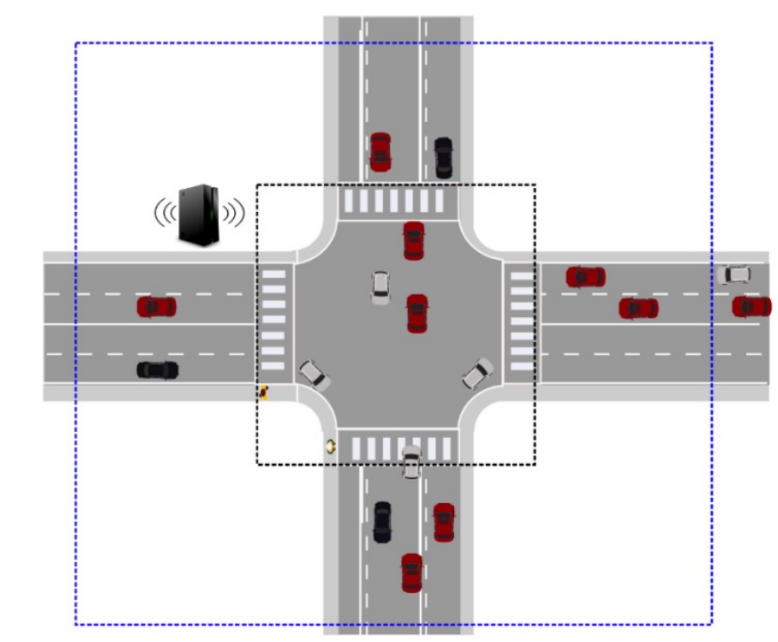
Resource Access Protocol In Autonomous Traffic Control System
Abdullah Al Forkan
Matriculation Number: 2190314

Slide 2
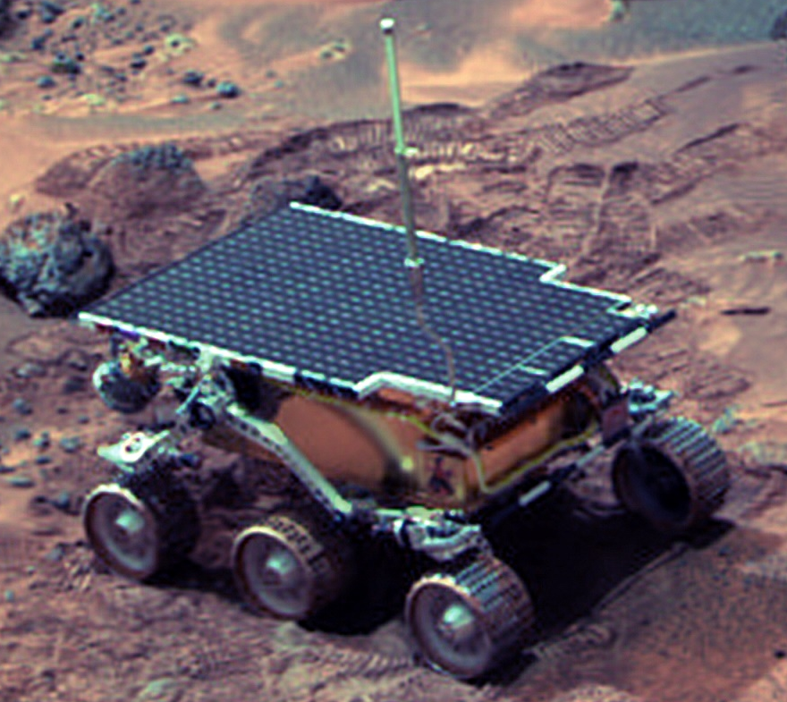
Motivation
We are living in a world now, where data is everything and all processes of system shares the same data to maintain connectivity. The initial inspiration came while I was trying to solve the priority queue for a autonomous traffic control system. The problem was to setting the priority for each cars in the queue in the main shared resource. Similar problem can also be observed in Mars path finder incident happened in 1997.

Slide 3
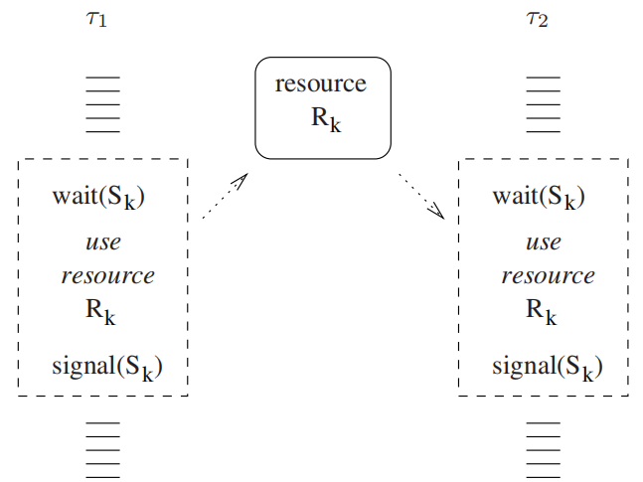
Resource Access Protocol
Shared Resources:
Data structures,
variables,
main memory area,
files,
set of registers,
I/O units,
the processor, etc.
Mutual exclusion, critical Section
• When a job enters the critical section of a shared resource, the accesses to the shared resource from other jobs are blocked.

Slide 4
Autonomous Traffic Control
Server Queue
Priority 1 | Car 1
Priority 2 | Car 2
Priority 3 | Car 3
Priority 4 | Car 4
In a 4-way cross sectional road, autonomous traffic control system is controlled by a priority server queue.
Generally, vehicles are set to the queue as soon as they come.
But fixed priority system for Resource Access creates a big problem.
Like the Pathfinder system reset.

Slide 5
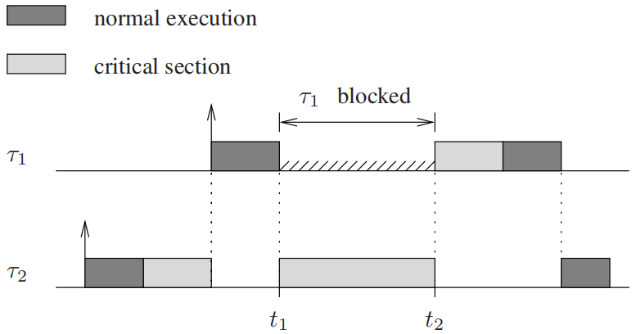
Priority Inversion Problem
RESET
A higher priority job is blocked by a lower-priority job.

Slide 6
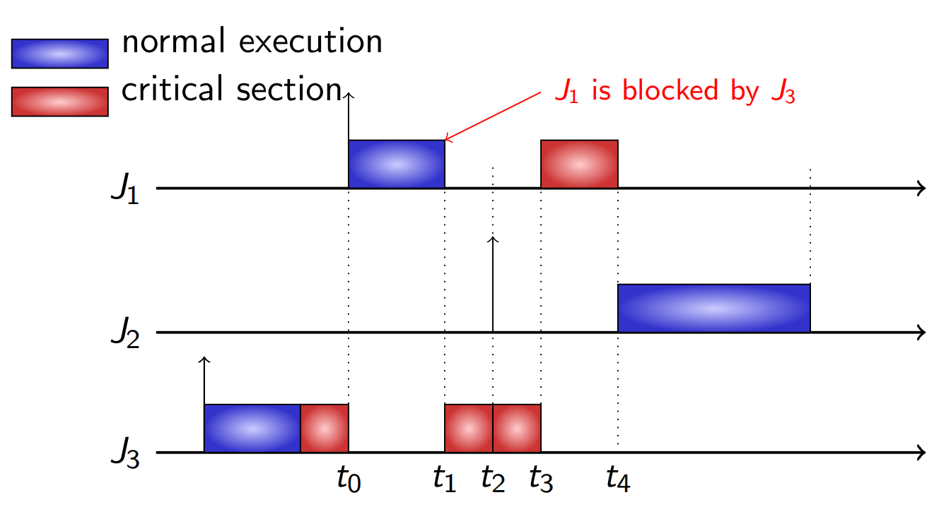
Priority inheritance protocol.
• T0: J1 arrives and preempts J3
• T1: J3 inherits J1’s priority
• T2: J2 arrives and has a lower priority than J3
• T3: J3 leaves, and J1 now preempts J3.
• T4: J1 finishes, and J2 is the highest-priority task.
When a lower-priority job blocks a higher-priority job, the priority of lower job is promoted to the priority level of highest-priority job.

Slide 8
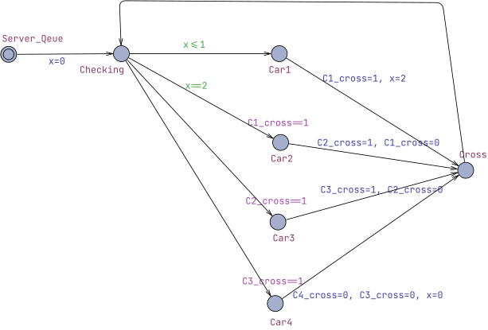
UPPAL Simulation

Slide 9
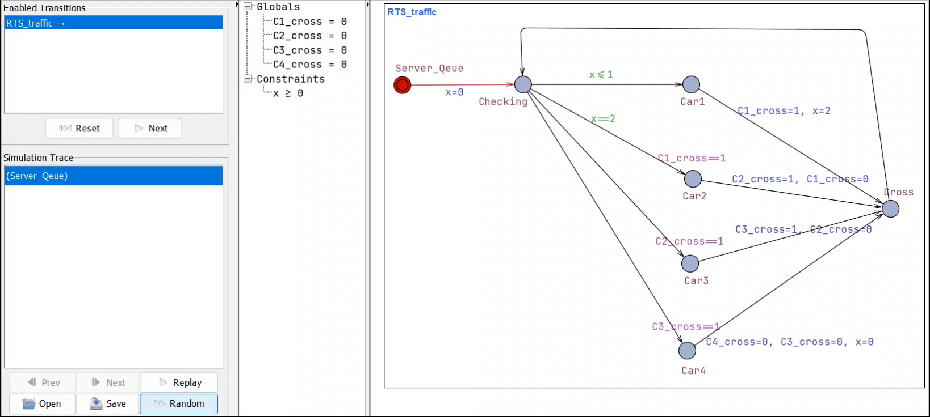
UPPAL Simulation

Slide 10
REFERENCES
1. BUTTAZZO, Giorgio C., ed. Hard real-time computing systems: Predictable scheduling
algorithms and applications. Real-time systems. Kluwer Academic Publishers, Boston and
Dordrecht and London, 1997.
2. Pathan, R.M. (2012). Report for the Seminar Series on Software Failures Mars Pathfinder: Priority Inversion Problem.
3. Prof. Dr. Jian-Jia Chen(2016),Resource Access Protocols, LS 12, TU Dortmund.
4. Mike Jones, email- Subject: What really happened on Mars?, Sunday, December 07, 1997.
http://research.microsoft.com/en-us/um/people/mbj/mars_pathfinder/Mars_Pathfinder.html

